Slide 1
TankX – Aytekin Erdogan
Quantitative Analyst (HFT)

Slide 2
Outline
Resume In a Nutshell
Solution Overview - Triangular Arbitrage
Discussion

Slide 3
Resume In a Nutshell

Slide 4


Currently
Software Engineer - 5G TN
Mid-Senior C++ Developer
TDD, Agile, CI/CD
150+ SWE (Sweeden, Poland, Turkey)
Selected as Key Contributor, awarded with stock option
PhD Student in METU
Computer Vision Research
Image Fusion
Low Light Image Enhancement
…

Slide 5

Education
BSc in Electrical and Electronics Engineering (2019)
Rank: 8/130
Signal Processing
Embedded Systems
MSc in Informatics (2023)
Deep Learning Based Computer Vision
Thesis: A Transformer-Based Approach for Fusing Infrared and Visible Band Images

Slide 6

Education (cont’d)
Isiklar Air Force Military High School
Rank: 11/171
Swimming, Former Professional Athlete
Social Entrepreneurship
Debate, Former National Debate Team Candidate.
3 sorties microlight,
5 sorties glider
10+ sorties Cessna 171

Slide 7


Work Experience
Software Engineer – CV
Contract (06/22-01/23)
Multi-View Geometry
NeRF & 3D Reconstruction
Early-stage Startup (New York)
Software Engineer – CV
Full-time (09/21-06/22)
Perception for Autonomous Vehicles
2D/3D Object Detection
Obstacle Detection

Slide 8

Work Experience
Software Engineer
Full Time (08/18-04/21)
C++ applications for communication sys
Embedded: Xilinx UltraScale
Autonomus Driving: Obstacle Detection
Face / License Plate Recognition

Slide 9
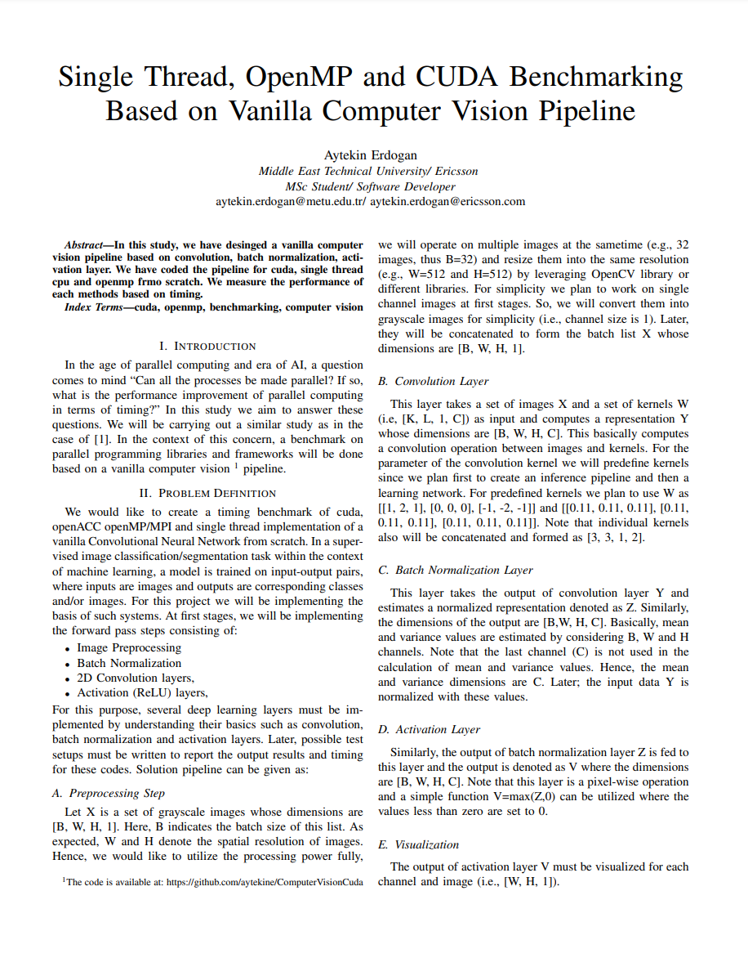
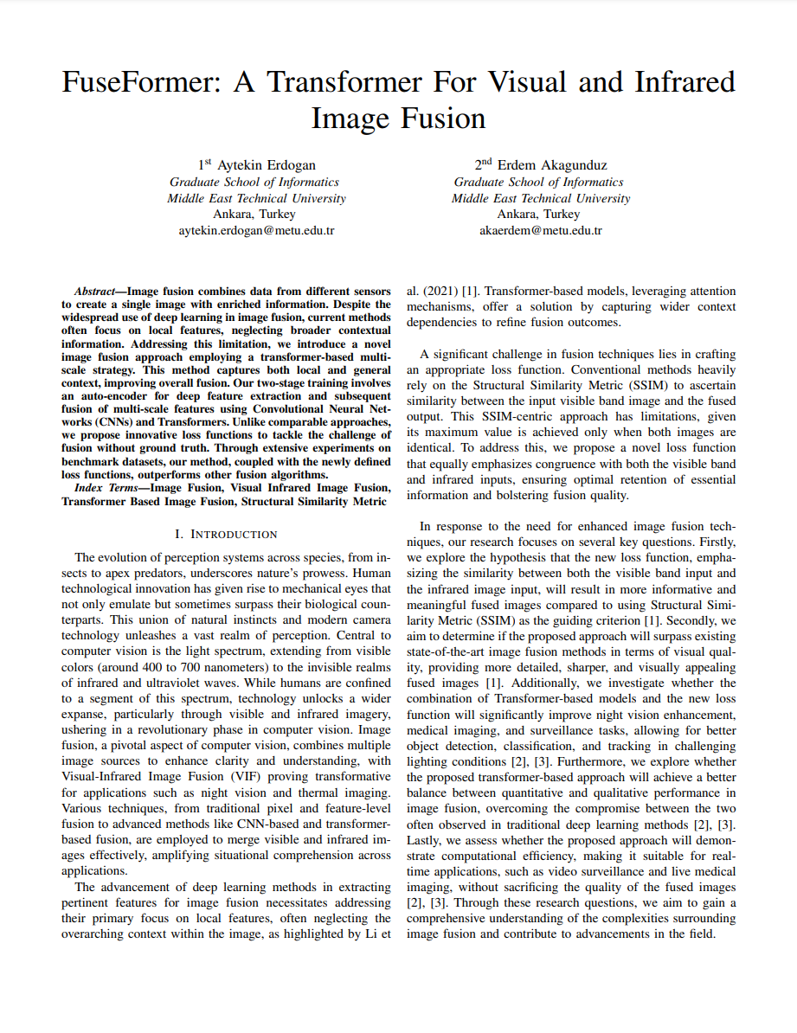
Academic Outputs: Publications

Slide 10
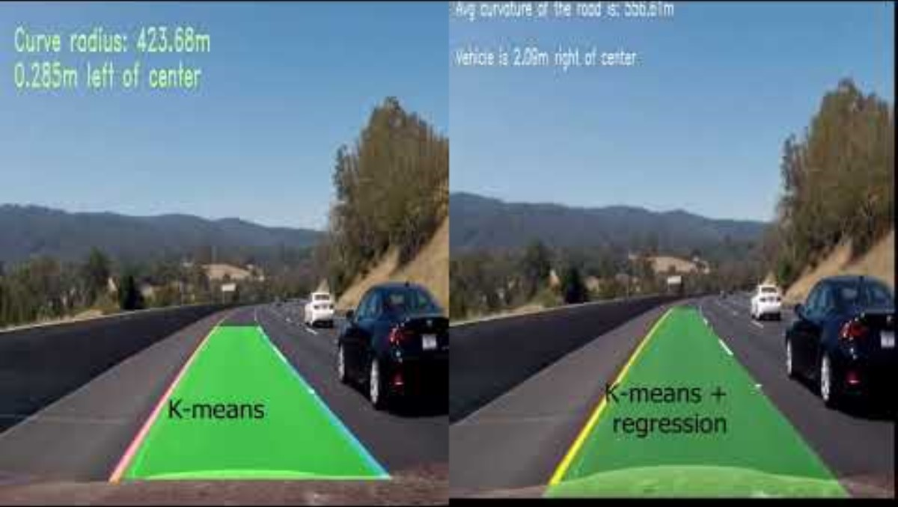

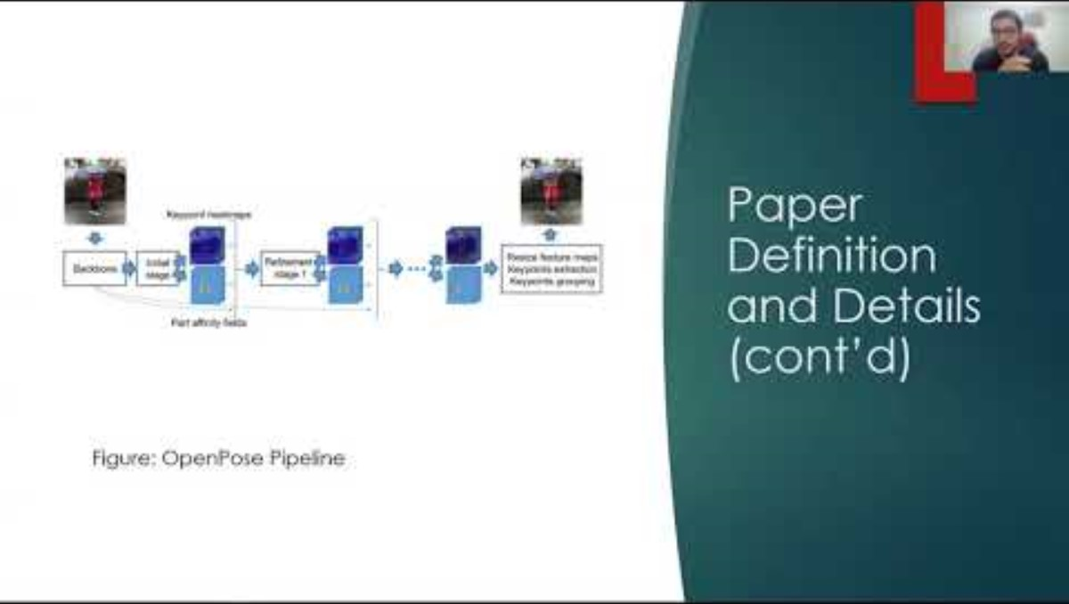
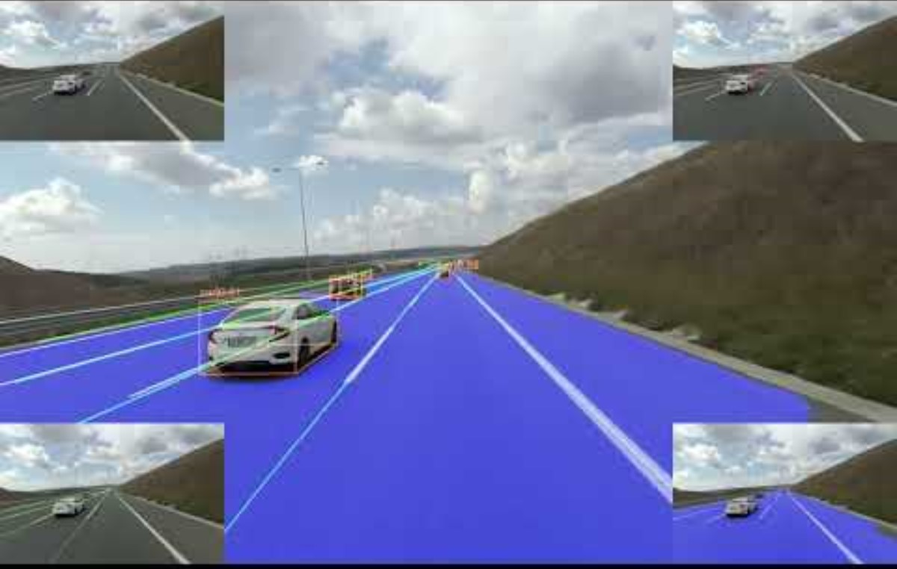
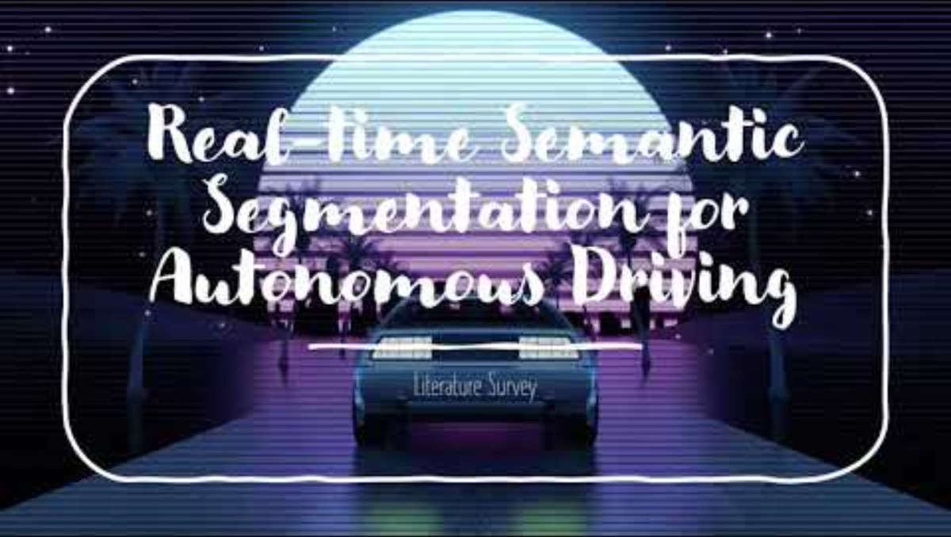
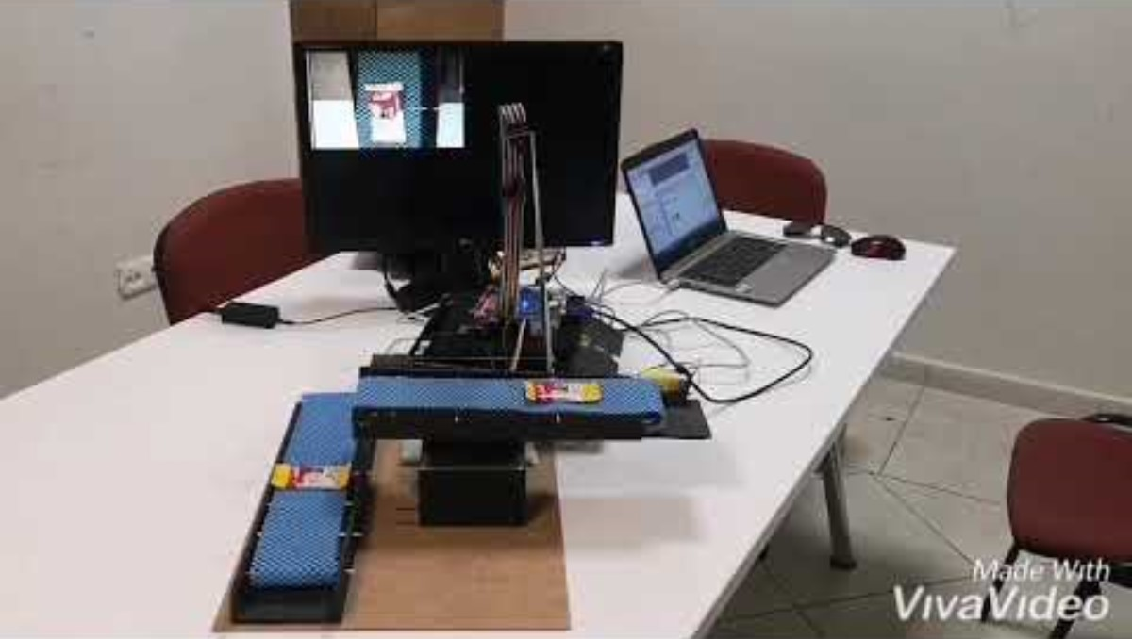
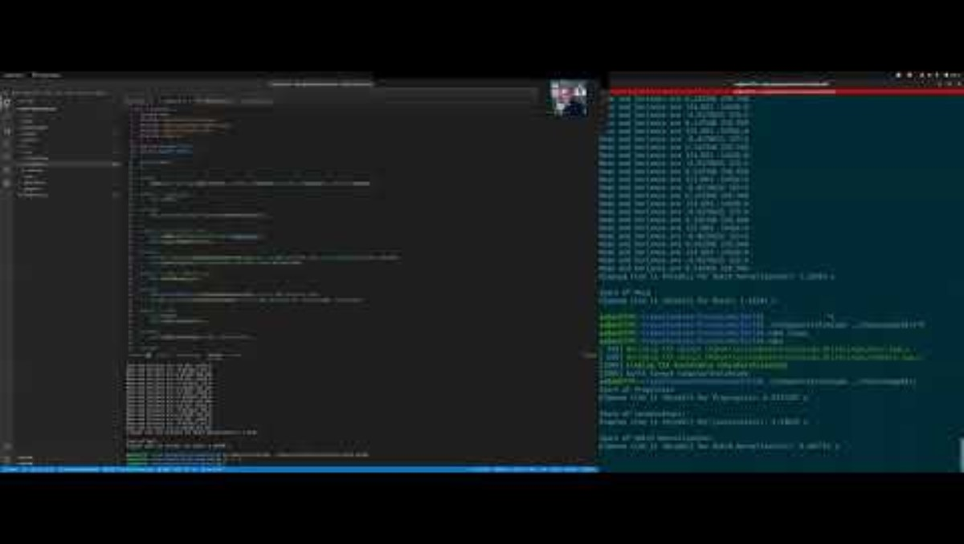
Academic Outputs: Projects

Slide 11







Abilities, Frameworks & Tools

Slide 12
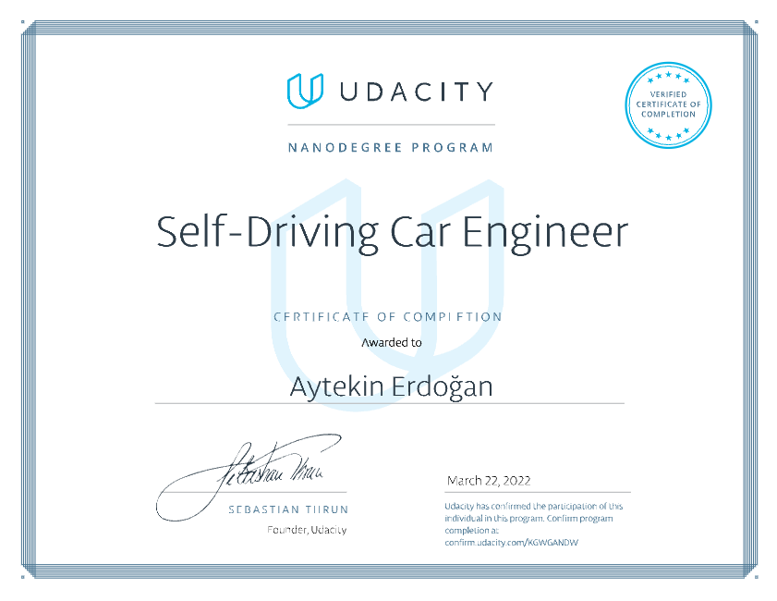
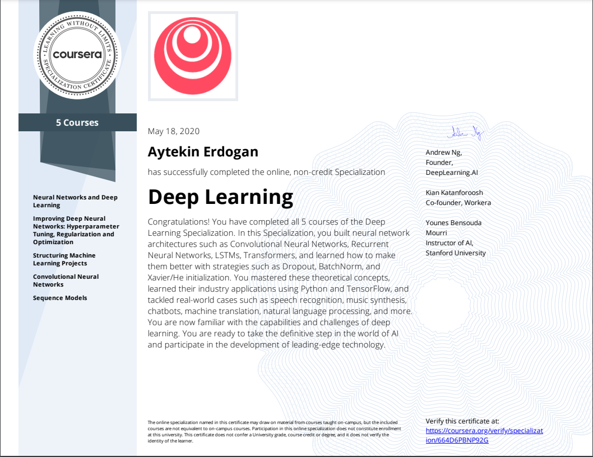
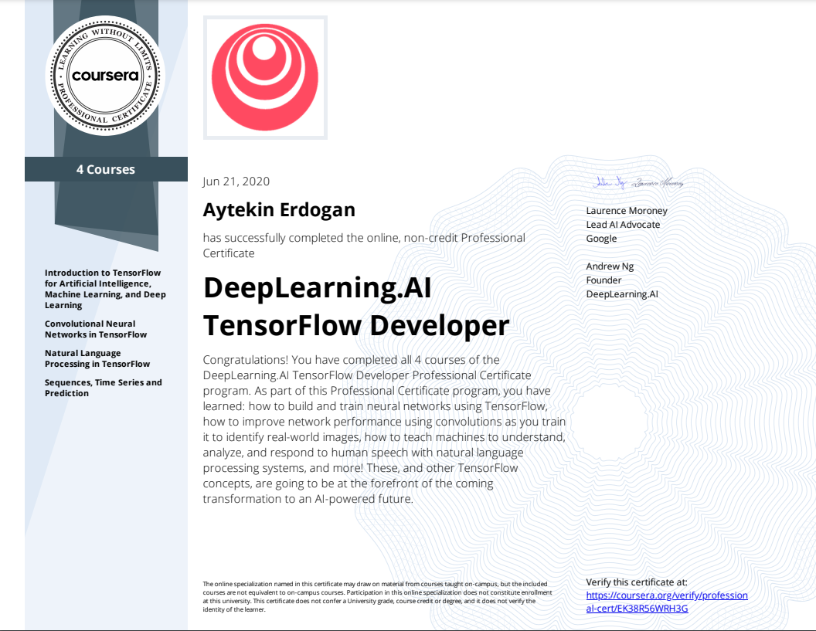
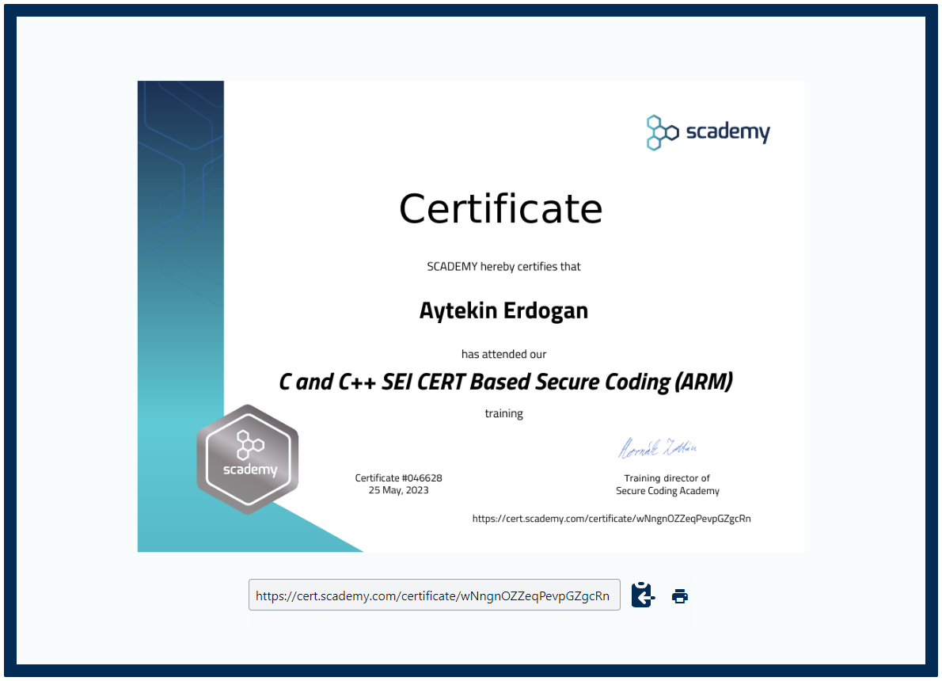
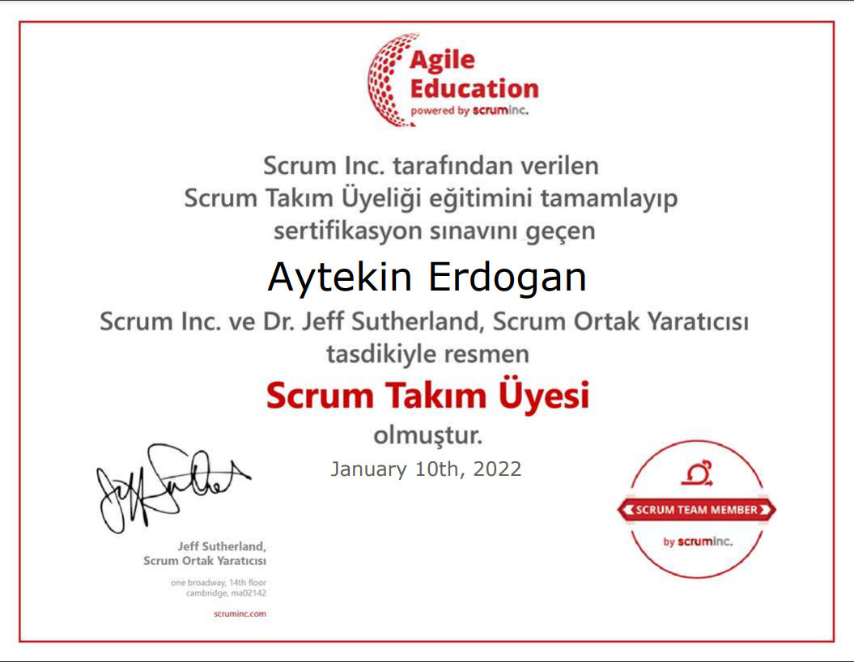
Licenses & Certifications

Slide 13


Things I Failed: Schools
Air Force Academy
BSc in EE (2015-2016)
Failed Coup Attempt
TU Dresden
MSc in CS (2020-2021)
Covid-19 Pandemic

Slide 14
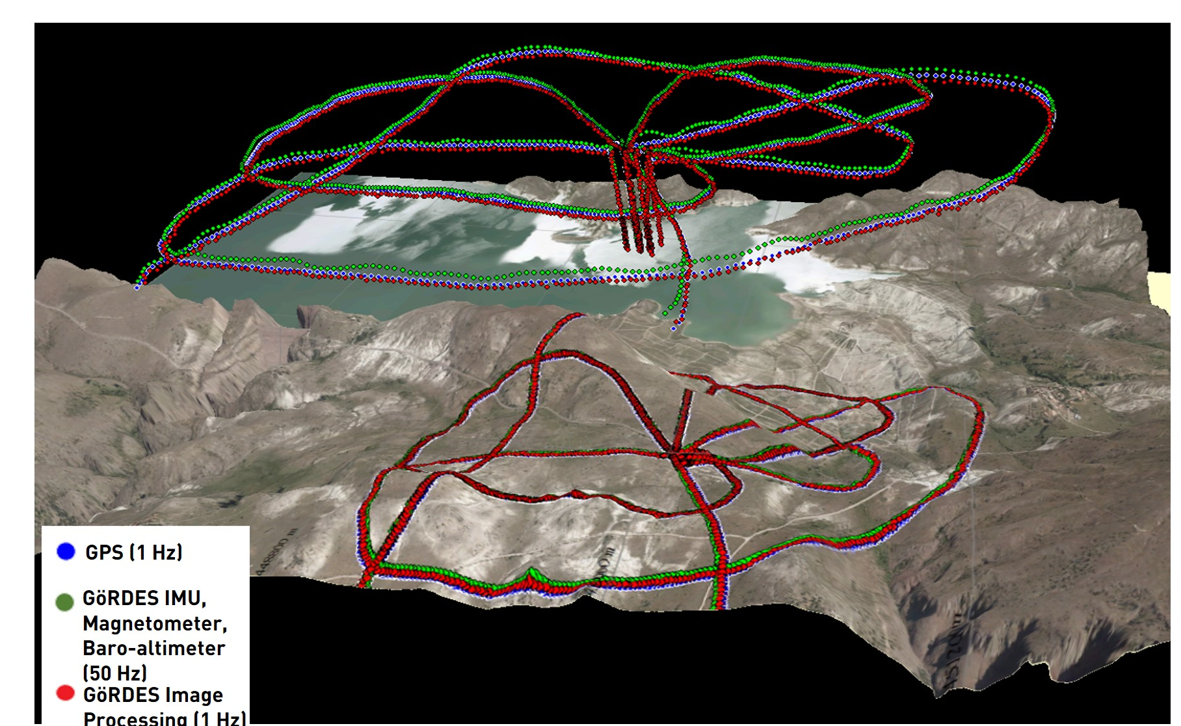
Thins I Failed: Projects
A Startup Idea:
GPS- Independent Navigation System
Outdoor SLAM Based Navigation System
Phase 1: Operating over Day Time
Phase 2: Operating over Night Time
LIDAR Support,
Thermal Camera Support.
Phase 3: Operating over Unknown Territory

Slide 15
Thins I Currently Working On:
Visual Cryptography:
Hiding data on visuals. (not meta-data embeddings)
Usecase: detecting copyright infringement with stolen content.
Model Quantization:
Usecase: real-time capabilities of deep models.

Slide 16
Solution Overview - Triangular Arbitrage

Slide 17
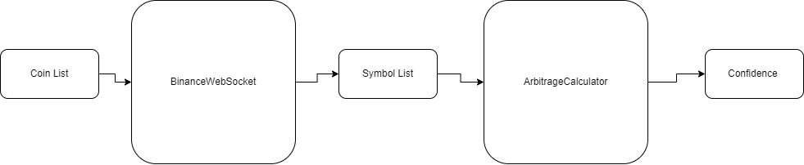
Overview

Slide 18
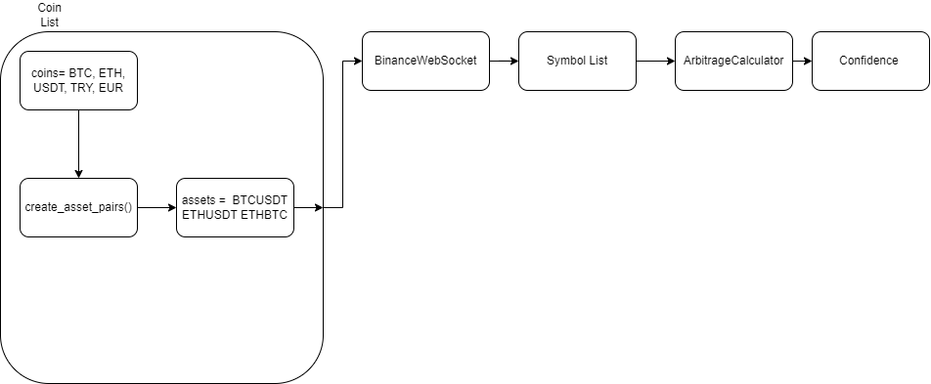
Generating Asset List

Slide 19
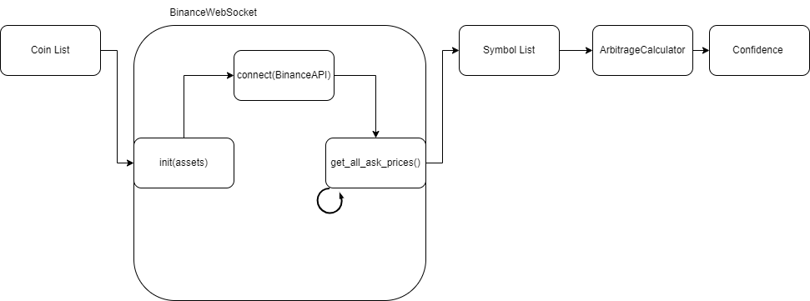
Getting Symbols from Binance Web API

Slide 20
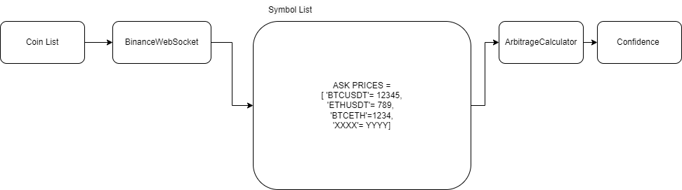
Produce & Consume Queue

Slide 21
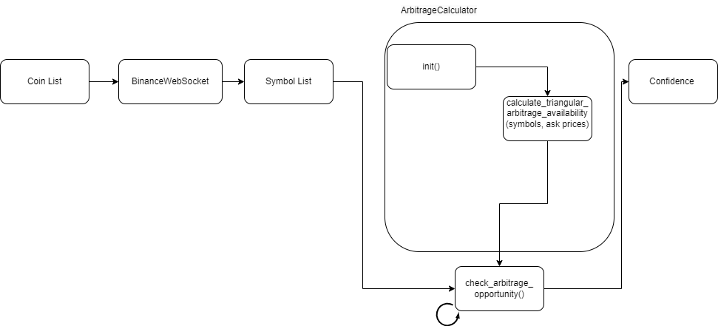
Check Arbitrage Opportunity

Slide 22
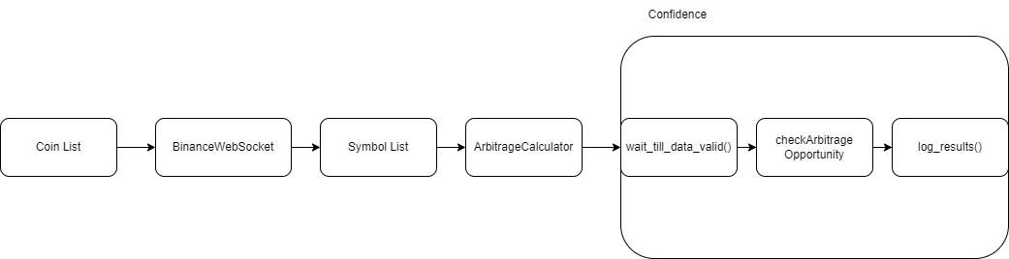
Decision Making

Slide 23
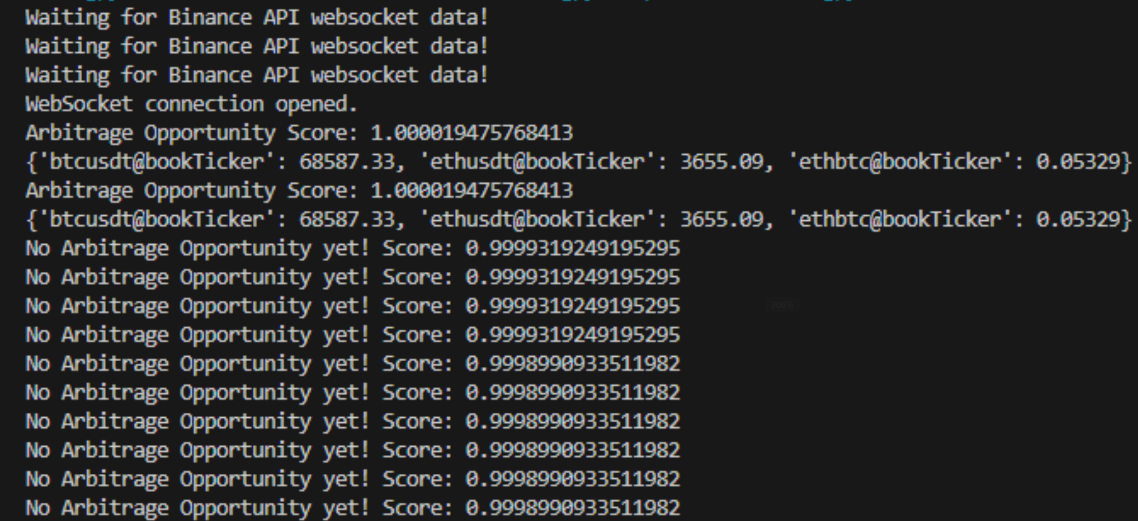
Result

Slide 24
Discussion

